Slide 1

Charles M. Harris
Shenghua Zha
James Madison University
Knowledge is Liberty
James Madison
Concept Mapping:
Rationale, Technologies, Types, & Applications
Notes:
C & S Introductions

Slide 2
Concept Mapping:
Rationale
Notes:
C: Why concept mapping?

Slide 3
One who knows the Why of life
Can cope with any How
Gibran
Notes:
C: A recurring challenging confronting all of us is maintaining our focus on why we do that which we do….why we teach.

Slide 4
Development of critical thinking skills
is the hallmark of American education’s mission
to create thinking citizens for a free society
(Scott, 2005).
Approximately 50% of college students
do not demonstrate significant gains
in critical thinking skills
during the first two years of college
(Blaich, 2007; Arum and Roksa, 2011)
Notes:
C: What’s the problem…What’s the solution to facilitating CT?

Slide 5
Content
Process
Notes:
C: My dilemma…so much content…15 chapters in 15 weeks… or CT

Slide 6
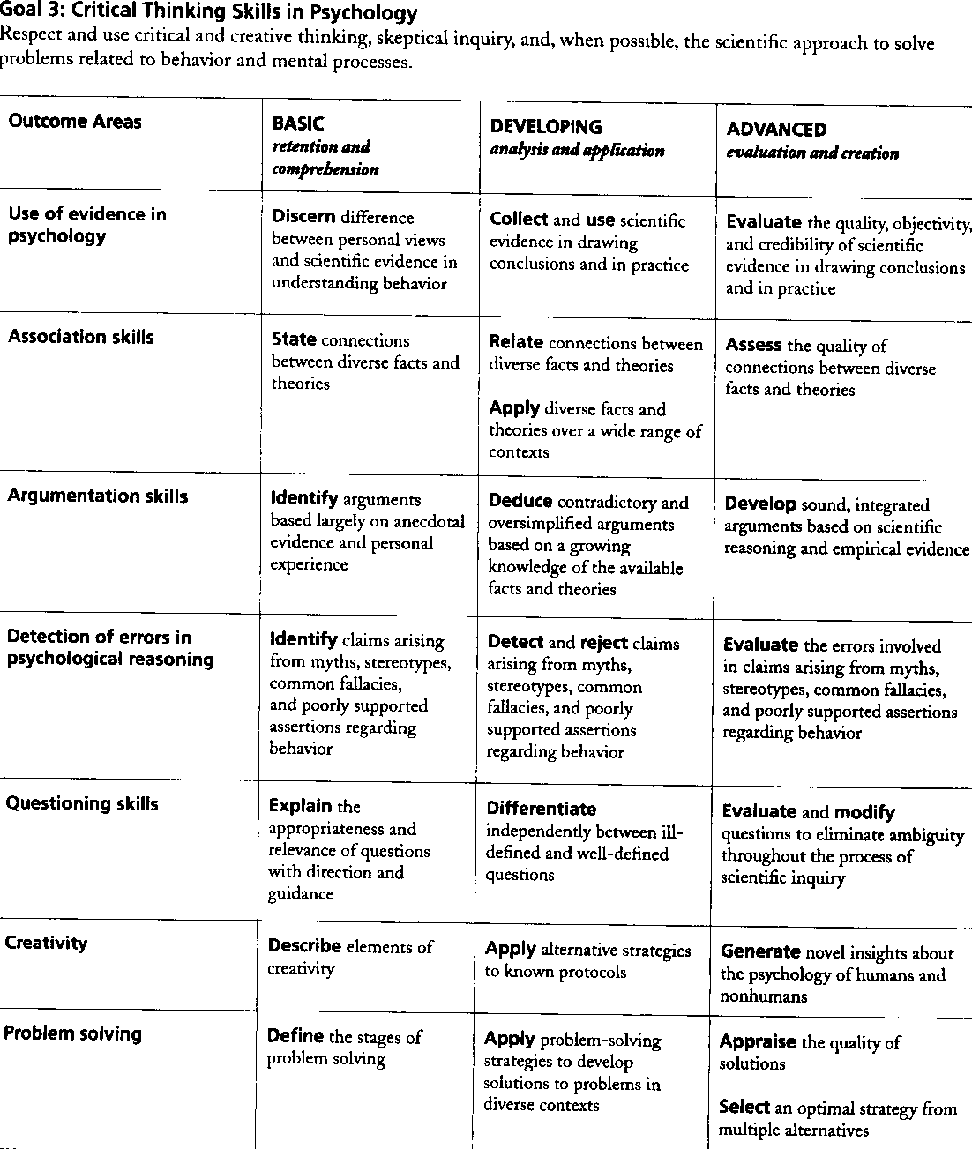
Notes:
C: P 21, American Psychological Association. (2008). Teaching, learning, and assessing in a developmentally coherent curriculum. Washington, DC:
American Psychological Association, Board of Educational Affairs.

Slide 7
Goal 3: Critical Thinking Skills in Psychology
Association Skills
Basic: Retention and Comprehension
State connections between diverse facts/concepts and theories
Developing: Analysis and Application
Relate connections between diverse facts/concepts and theories
Apply diverse facts/concepts and theories in various contexts
Advanced: Evaluation and Creation
Assess the quality of connections between diverse
facts/concepts and theories
Notes:
C: Progressive development of CT

Slide 8
Associative Learning:
Internal cognitive representations
for functionally relating
two or more concepts
Concept Maps:
Graphic organizers (diagrams) show relationships among concepts in order to visually depict the structure of knowledge
Notes:
S: Associative Learning is an “internal” cognitive process. Concept Mapping is an “external” graphic depiction of the “structure of knowledge”.

Slide 9
A Picture is Worth…Words
…pictures and line drawings
are often more easily comprehended than the words that represent
an abstract concept
(Terry, 2003)
Notes:
S: How many words is a picture worth for you? Terry would choose “pictures and line drawings” over abstract words.
Terry, W. S. (2003). Learning and memory basic principles, processes, and procedures. 2nd
Edition. Boston: New York.

Slide 10
Concept Map
Can be used to
Contains
Visualize
Information
Two Important
Components
Such as
Such as
One is
The other is
Terminology
Ideas
Major
Topics
Linking
Words
For
That
That
Branch
to
That
Integrating new information into prior knowledge
Explain
relationships
between
topics/concepts
Subtopics
Decribe
relationships between
topics/concepts
Notes:
S: We’ll use a concept map to describe “concept maps”.

Slide 11

Concept: Age
Notes:
S: You say, “We thought about having you turn to someone and exchange your ages, but, as an alternative, turn to someone and estimate our ages (mine and yours).”

Slide 12
CmH’s Date of Birth
April 22, 1936
77 years & 5+months
Notes:
S & C: Charles says, “Now that you know my chronological age, what do you know about me? Answer: Only sociocultural information.

Slide 13
Concept: Age
Notes:
S & C: Audience participation: Distribute the Hand Out: Keep the “Concept: Age” side up [Demonstrate]. Don’t turn paper over or look at the reverse side until instructed to do so.
Allow time for reading the Concept: Age, then say, “Now, turn your sheet over and take the brief quiz WITHOUT looking back at the text for the Concept: Age.
Allow time for completion of the quiz.
Query group for answers to the quiz, then go to next slide.

Slide 14
Concepts of Age
Chronological age is the number of years that have elapsed since birth. However, time is a crude index of experience and does not cause anything. Moreover, just as there are different domains of development, there are different ways of thinking about age.
Biological age is a person’s age in terms of the functional capacities of a person’s vital organs. One person’s vital capacities may be better or worse than the vital capacities of others of the same chronological age. The younger a person’s biological age, the longer that person is expected to live, regardless of chronological age.
Psychological age is an individual’s adaptive cognitive capacities compared with other individuals of the same chronological age. Older adults, who continue to learn, are more flexible, motivated, in control of their emotions, and think more clearly than their chronological age-mates who do not continue to learn.
Social age refers to the extent to which one’s behavior is consistent with one’s social roles and expectations compared with others
of the same chronological age. Consider the role of “mother” and the behaviors that accompany that role. When predicting an adult woman’s behavior, it would be more important to know that she is the mother of a child, 3-years-of-age, than to know than to know her chronological age.
Chronological age
of the same chronological age
Psychological age
of the same chronological age
of the same chronological age
Notes:
C: Direct attention to the text for answers to the quiz.

Slide 15
Concepts of Age: Coherence
Chronological
Referenced to
Referenced to
Social
Biological
Referenced to
Psychological
Notes:
C: Display concept map of “coherence” among the concepts of age.

Slide 16
Concepts of Age: Interaction
Chronological
Interacts with
Interacts with
Social
Biological
Interacts with
Interacts with
Interacts with
Interacts with
Psychological
Notes:
C: Display concept map of “interaction” among the concepts of age.

Slide 17
Concept Mapping:
Technologies
Notes:
S:There are technologies for concept mapping that make it possible to use concept mapping with groups of any size.

Slide 18
Technologies for Constructing Concept Maps
Features
X
X
X
X
Notes:
S: Shenghua, after your introductory comments about the Features, click to show each of the four technologies and finally the arrow showing that Cacoo is our current choice.

Slide 19
Cacoo
for Constructing Concept Maps
Youtube Cacoo Video
http://vimeo.com/23595413
Notes:
S: First, click on “Cacoo” to display the Youtube URL for a short video demonstrating concept mapping with Cacoo. Then, play the Youtube Cacoo video.

Slide 20
Concept Mapping:
Types
Notes:
S: There are many types of concept maps. No one type is always the best choice for all situations or for all people.

Slide 21
Types of Concept Maps
Systems
Depict comprehensive, integrated data for critical thinking
Spider
Do not depict integration of data for critical thinking
Hierarchical/Chronological
Do not depict integration of data for critical thinking
Flow Chart
Depict minimal data for critical thinking
Notes:
S: We will briefly display the defining characteristic of each of four of the most commonly used types of concept maps.
For Systems Concept Maps, the key words are “comprehensive and integrated data”.
For Spider and Hierarchical Concept Maps, the key words are “Do not depict integration of data…”
For Flow Chart Concept Maps, the key words are “Depict minimal data…”

Slide 22
Systems Concept Map: Age
Explained as
Definition
Incorporates
Chronological
Domain
Basis for
Interacts with
Interacts with
Assessment
Referenced to
Referenced to
Referenced to
Interacts with
Social
Biological
Interacts with
Explained as
Explained as
Interacts with
Interacts with
Definition
Definition
Delimits
Delimits
Psychological
Domain
Basis for
Domain
Explained as
Definition
Assessment
Basis for
Delimits
Domain
Assessment
Basis for
Assessment
Notes:
C: Display depiction of integration of data

Slide 23
Spider Concept Map: Ages
Chronological
Definition
Age
Social
Biological
Domain
Assessment
Psychological
Notes:
C: Display unintegrated content.

Slide 24
Hierarchical Concept Map: Memory
Memory
Short-term
Long-term
Encoding
Elaboration
Organization
Retrieval
A
A
A
A
P
P
P
P
A = Activation
P = Process
Notes:
C: Display unintegrated content.

Slide 25
Systems Concept Map: Memory
Memory
Short-term
Long-term
Encoding
Elaboration
Organization
Retrieval
A
A
A
A
P
P
P
P
A = Activation
P = Process
Notes:
C: Display conversion from “H” to Systems CM

Slide 26
Flow Chart Concept Map: Memory
Encoding
Elaboration
Organization
Retrieval
Notes:
C: Display “minimal data”

Slide 27
Concept Mapping:
Applications
Notes:
S: Ask the audience, “In what ways have you used concept maps?”
After audience response, go to next slide.

Slide 28
Concept Mapping Applications
Model Critical Thinking:
Instructor demonstrates CT
Students replicate CT
Students elaborate (What, How, Why)
Content Delivery:
Macro level (Course, Module, Lecture)
Micro level (Specific Complex Concepts)
Asssessment:
During a Learning Activity
Prior Knowledge
Current Comprehension
During Testing
Individually
Collaboratively
Notes:
S: The “Model Critical Thinking” sequence is based on Vygotsky’s two concepts: (1) the Zone of Proximal Development and (2) Scaffolding.
After the instructor demonstrates and the student replicates critical thinking, Vygotsky emphasizes that students should be given an opportunity to state (a) What they did, (b) How they did it, and (c) Why they did it. The outcomes are that students both exercise critical thinking and comprehend the process of critical thinking.
Zone of Proximal Development: The level at which a student can almost, but not fully perform a task independently, but can do so with the assistance/modeling of someone more competent.
Scaffolding: The support for learning and problem solving that encourages independence and cognitive development.

Slide 29
Studies of Effectiveness
in Learning Complex Concepts
Study One: Efficacy 0f CM
Study Two: Timing 0f CM
General Education/Psychology Course
First-year Students
Notes:
S: Overview of our two studies.

Slide 30

Study One-Concept of Age
 | N | Mean | SD | F | df | p
Section 1 | 63 | 3.95 | 1.10 | 4.662 | 3 | 0.003
Section 2 | 62 | 4.66 | 1.34
Section 3 | 53 | 3.85 | 1.39
Section 4 | 62 | 4.10 | 1.36
Notes:
S & C: In Study One, we compared the Concept of Age scores of students who used the concept mapping (Sections 2 and 4) and who did not (Sections 1 and 3) when preparing for their tests.
Significant differences are found on students' scores on Concepts of Age (p<0.01). Students in Section 2 had the highest score. Students in Sections 1 and 3 had the lowest score.
The chart represents the Means of Critical Thinking of Students’ Score in the Test of Concepts of Age in the Four Sections. The Y-axle refers to the means of the critical thinking score while the X-axle represents the four sections in Study One.

Slide 31
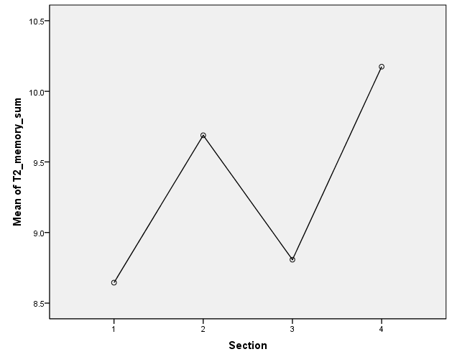
Study One-Memory
 | N | Mean | SD | F | df | p
Section 1 | 62 | 8.65 | 2.90 | 4.710 | 3 | 0.003
Section 2 | 61 | 9.69 | 2.39
Section 3 | 52 | 8.81 | 2.72
Section 4 | 63 | 10.13 | 2.39
Notes:
S & C: We also compared the Memory scores of students who used the concept mapping (Sections 2 and 4) and who did not (Sections 1 and 3) when preparing for their tests. There is statistically significant difference between session means as determined by one-way ANOVA (F(3,235) = 4.485, P <0.01). In particular, students in Sessions 2 and 4 had significantly better performance than students in Session 1 (p1-2<.05, p1-4<.01).
The chart represents the Means of Critical Thinking of Students’ Score in the Test of Memory in the Four Sections. The Y-axle refers to the means of the critical thinking score while the X-axle represents the four sections in Study One.

Slide 32
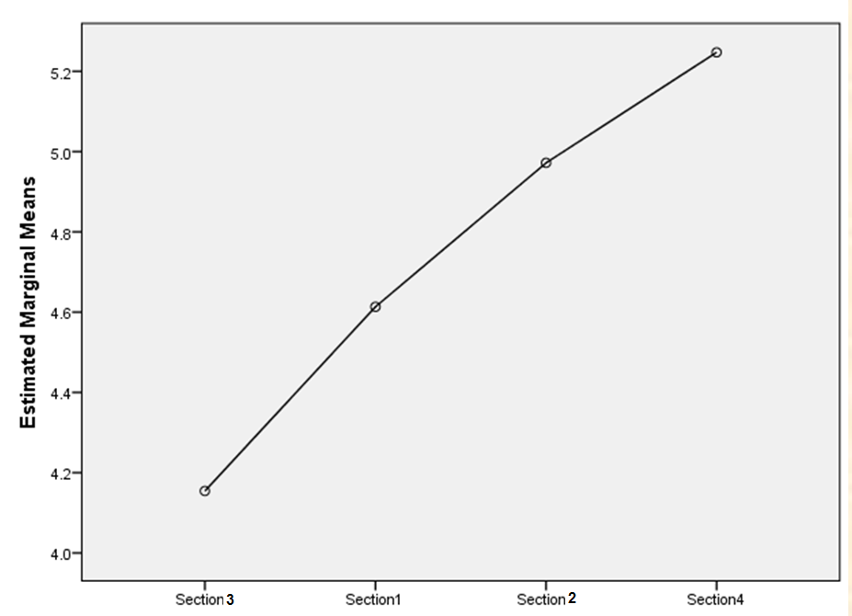
Study Two-Concept of Age
 | N | Mean | SD | F | df | p
Section 1 | 52 | 4.62 | 1.26 | 8.893 | 3 | 0.000
Section 3 | 59 | 4.14 | 1.21
Section 2 | 66 | 4.98 | 1.21
Section 4 | 52 | 5.25 | 1.12
Notes:
S & C: In Study Two, we examined the Concept of Age scores of students who were asked to submit their concept maps before the tests (Sections 2 + 4) and who submitted their concept maps immediately after the class (Section 1 + 3).
Significant differences were found on students' scores on Concepts of Age (p<0.01). Students’ who were asked to submit their concept maps before Test 1 had better scores on the Concepts of Age then students who were asked to submit their concept maps immediately after class.
The chart represents the Means of Critical Thinking of Students’ Score in the Test of Concepts of Age in the Four Sections. The Y-axle refers to the means of the critical thinking score while the X-axle represents the four sections in Study Two.

Slide 33
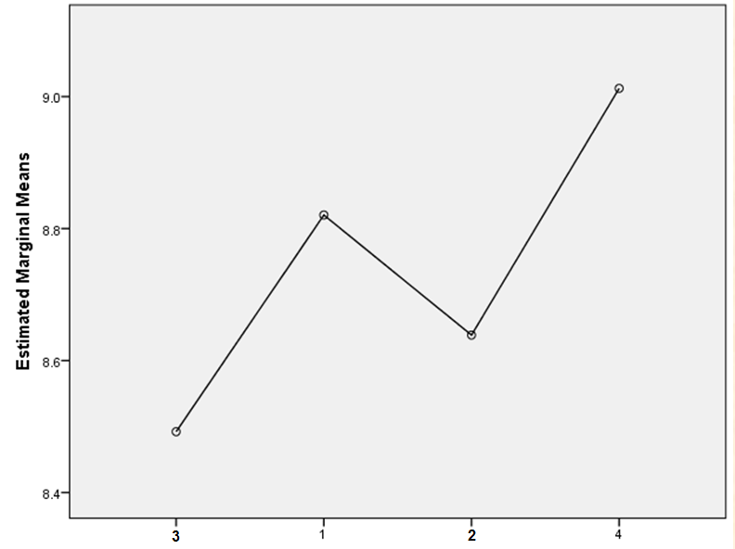
Study Two-Memory
 | N | Mean | SD | F | df | p
Section 1 | 54 | 8.83 | 2.96 | 0.343 | 3 | 0.794
Section 3 | 60 | 8.45 | 2.46
Section 2 | 65 | 8.66 | 3.04
Section 4 | 52 | 9.02 | 3.04
Notes:
S & C: We also examined the Memory scores of students who were asked to submit their concept maps before the tests (Sections 2 + 4) and who submitted their concept maps immediately after the class (Sections 1 + 3).
No significance were found in this test.

Slide 34
Concept Mapping
A Technique for
Teaching & Learning
Charles M. Harris Shenghua Zha
James Madison University
Notes:
S & C: Conclusion

